Slide 1
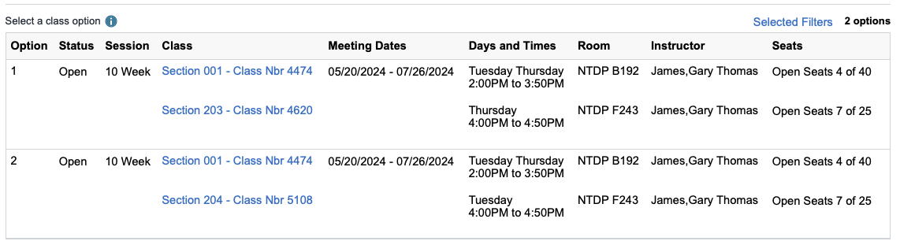
CSCE 2610
Assembly Language and Computer Organization
Instructor: Dr. Gary James
Class: Tu – Th. 2:30 – 3:50
Recitation:
Chapter 1 — Computer Abstractions and Technology — 1

Slide 2
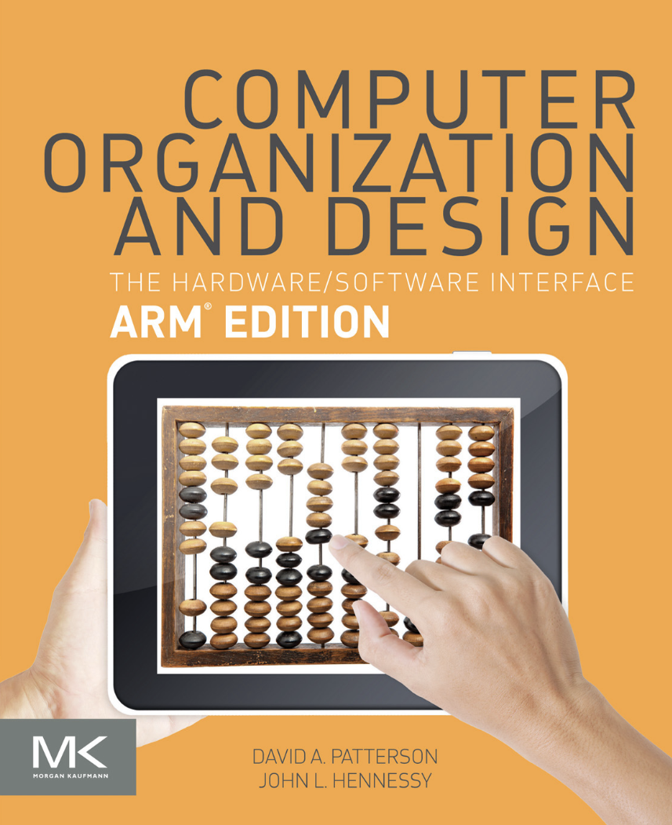

Slide 3
CSCE 2610: Assembly Language and Computer Organization The Hardware and Software Interface
Instructor: Gary James, (gary.jamesi@unt.edu)
Office Hours: scheduled
TA: TBD
(@my.unt.edu)
Office Hours:

Slide 4
Now Back to Business
Assembly Language COMP ORG (Recitation) CSCE 2610-201 We 10:30AM - 11:20AM NTDP F243
CSCE 2610-205 Mo 11:30AM - 12:20PM NTDP F210
Chapter 1 — Computer Abstractions and Technology — 4

Slide 5
How will you be graded?
Tentative Breakdown Of Course Grade
Class Activity (Pop Quizzes) 10%
Programming Assignments 20%
Chapter Review Tests 20%
Comprehensive Final Exam 50%
Discretion 2%
I reserve the right change these weights
Chapter 1 — Computer Abstractions and Technology — 5

Slide 6
General Info
You will be given both pen and paper type assignments and
programming assignments using ARM assembly language
You can use MyLab to connect to the tools needed
your login id will be your euid, and password will be your UNT password
You will need to access DS 5 system to run ARM assembly language programs
You can also download DS 5 on your personal computer (installation is a bit involved)
Instructions for all these options will be available soon
Chapter 1 — Computer Abstractions and Technology — 6

Slide 7
Some bookkeeping
Text: D.A. Patterson and J.L. Hennessy. "Computer organization and design:
The hardware/software interface" ARM Edition (ISBN: 978-0-12-801733-3)
Do not purchase 5th edition or RISC V editions
Textbook is for you to read. Not for me to read it to you
I will use some examples from the text, some my own.
I may change the order in which I present material
You may want to consider buying ZyBooks version of the textbook
Animations, demos etc
See me or TAs at the earliest if you do not understand the material or not doing well in class
DO NOT WAIT UNTIL IT IS TOO LATE (into the semester)
And problems do not miraculously disappear!
Chapter 1 — Computer Abstractions and Technology — 7

Slide 8
Ethics
All students will be trusted to pursue their academic careers with honesty and integrity.
Academic dishonesty includes, but not limited to, cheating on a test or other course work, plagiarism, unauthorized collaboration with other persons.
Students found guilty of dishonesty will be subject to penalties that may include suspension from the university.
Specific Course Objectives
Understand the role of the different classes and components in a computer system and the interface between software and hardware in a computer system.
Apply metrics to evaluate performance of a computer system using clock rate and clock cycles per instruction (CPI). Understand the different aspects of execution times reported when program complete their execution.
Understand instruction set choices and write assembly language programs for simple C code and codes that include procedures.
Perform integer and floating point calculations using computer arithmetic algorithms.
Describe the organization of a simple processor with data path and control path for simple instructions.
Describe the requirement of memory hierarchy and evaluate the performance of different cache organizations
Chapter 1 — Computer Abstractions and Technology — 8

Slide 9
Computer Organization V. Computer Architecture
Three most common abstractions that are of interest to us
1. Computer Organization. Defines how the processor components (HW) are connected, and how information flows between them
Central Processing Unit (CPU), Cache, Memory, I/O, etc
and components within a CPU (the various pipeline stages, registers etc)
CPU → Control unit and Arithmetic and Logic Unit (ALU)
Chapter 1 — Computer Abstractions and Technology — 9

Slide 10
Organization v. Architecture
2. Second type of architecture: Instruction Set Architecture (ISA).
Abstracts interface between hardware and software
... the attributes of a computing system as seen by the [assembly language] programmer, i.e. the conceptual structure and functional behavior, as distinct from the organization of the data flows and controls the logic design, and the physical implementation.
This is the language the hardware understands
To program in any language, you need to know
How data is represented and organized
Data Types & Data Structures:
Encodings & Representations
What are the Instructions or operations
operations, formats, addressing model
Chapter 1 — Computer Abstractions and Technology — 10

Slide 11
ARM Instructions
For example: to move data from memory to registers
LDUR X2, [X1, #8] // read memory location (X1)+8
// store the value read from memory in register X2
STUR X4, [X1, #8] // store the value from X4 to memory at address
// (X1)+8
Arithmetic
ADD X4, X2, X3 // X4 = X2 + X3
ARM assembly language defines ARM ISA
The processor actually executes ARM machine language or binary (not assembly language)
What is the difference between Assembly and machine language?
Note: the same instruction set can be implemented differently (AMD vs Intel)
Likewise ARM from TI may be different from ARM from Qualcomm in hardware
→ different organizations/micro-architecture
Chapter 1 — Computer Abstractions and Technology — 11

Slide 12
Everything, altogether, all at once
3. Computer Systems Architecture. This is the abstraction provided by a combination of Operating system defined functions and higher-level language libraries, etc.
This can be viewed as the API to the system → hiding lower levels of programming
The user does not program in assembly language. Any interaction with low-level components is facilitated by either OS calls, compilers and other libraries provided.
For the purpose of this class
Computer Architecture = Instruction Set Architecture + Machine Organization
→ ISA + Micro-Architecture
software
instruction set
hardware
Chapter 1 — Computer Abstractions and Technology — 12

Slide 13
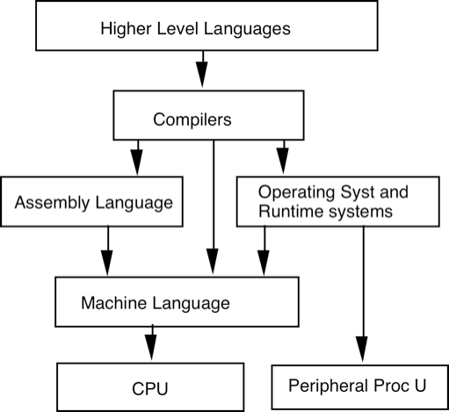
Layers of Abstraction
In general we can think of multiple layers –multiple levels of abstraction
Virtual vs Real machines
We can build hardware to implement any level architecture
Anything you can do in hardware, we can do in software
--> simulate hardware
i.e. : DS5 simulates ARM processor on Intel X’86 machines
Anything you can do in software, we can build hardware for it
i.e.: build hardware for encryption
Deep learning hardware
Hardware for sorting
Chapter 1 — Computer Abstractions and Technology — 13

Slide 14
Background
Virtual and Real Machines
Consider C, C++ or Java machine
What are the data types of this machine?
int, char, bool, floating point, arrays, structures, pointers,…
What are the data types of a real machine like x86 or ARM?
integer (16-bit, 32-bit or 64-bit), floating point (single or double precision), bytes (characters)
What are the operations of Java machine?
statements, if conditions, loops, method calls, exceptions,….
What are the operations of a real machine?
arithmetic/logic, load/store compare and branch, function call
We could directly build hardware to implement C language machine
Why don’t we see such machines?
Use abstraction to simplify design
How do we decide on what to support in hardware and what to support as a virtual machine (through a translator like a compiler in software)?
Chapter 1 — Computer Abstractions and Technology — 14

Slide 15
Background
Factors determining choice between HW and SW implementations
Flexibility
Cost
Speed
Generality
Frequency of expected changes
Memory requirements
Circuit resources double every 18 months
Twice as many transistors every 18 months (1.5 years)
Can be used to add more cores, more cache memory
May increase performance
Chapter 1 — Computer Abstractions and Technology — 15

Slide 16
The Computer Revolution
§1.1 Introduction
Progress in computer technology
Underpinned by Moore’s Law
Makes novel applications feasible
Computers in automobiles
Cell phones
Human genome project
World Wide Web
Search Engines
Computers are pervasive

Slide 17
Classes of Computers
Personal computers
General purpose, variety of software
Subject to cost/performance tradeoff
Server computers
Network based
High capacity, performance, reliability
Range from small servers to building sized

Slide 18
Classes of Computers
Supercomputers
High-end scientific and engineering calculations
Highest capability but represent a small fraction of the overall computer market
Embedded computers
Hidden as components of systems
Stringent power/performance/cost constraints

Slide 19
Classes of Computers
Supercomputers (UNT Talon → 8300 CPU cores, 150,000 GPU cores)
High-end scientific and engineering calculations
also for training machine learning algorithms
Highest capability but represent a small fraction of the overall computer market
Exa-scale computers (10¹⁸ FLOPs – floating point operations per second)
Find which are the CURRENT top 5 fastest machines at https://www.top500.org/
#1 is in USA (1100 Peta Flops), #2 Japan 700P Flops, #3 Europe 300 P Flops
#1 is in Japan (500 Peta Flops), next 2 are in US, next 2 are in China
Power requirements for supercomputers
Exa-Scale → 10¹⁸ Floating Point Operations per sec
The best Intel Xeon (6154 with 18 cores) claims 1 TFLOPS (10¹²) at 200 Wats
If we use these processors, we would consume 200 Mega Watts to get 1Exa-FLOP
The challenge posed by DoE is to achieve 1 Exa at 20-40MW (10 times less power)
Chapter 1 — Computer Abstractions and Technology — 19

Slide 20
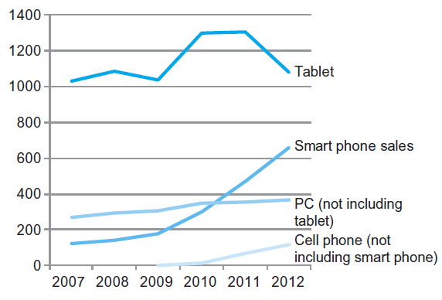
The PostPC Era

Slide 21
The PostPC Era
Personal Mobile Device (PMD)
Battery operated
Connects to the Internet
Hundreds of dollars
Smart phones, tablets, electronic glasses
Cloud computing
Warehouse Scale Computers (WSC)
Software as a Service (SaaS)
Portion of software run on a PMD and a portion run in the Cloud
Amazon and Google

Slide 22
What You Will Learn
How programs are translated into the machine language
And how the hardware executes them
The hardware/software interface
What determines program performance
And how it can be improved
How hardware designers improve performance
What is parallel processing

Slide 23
Understanding Performance
Algorithm
Determines number of operations executed
Programming language, compiler, architecture
Determine number of machine instructions executed per operation
Processor and memory system
Determine how fast instructions are executed
I/O system (including OS)
Determines how fast I/O operations are executed

Slide 24








Eight Great Ideas
Design for Moore’s Law
Use abstraction to simplify design
Make the common case fast
Performance via parallelism
Performance via pipelining
Performance via prediction
Hierarchy of memories
Dependability via redundancy
§1.2 Eight Great Ideas in Computer Architecture

Slide 25
8 Great Ideas in Computer Arch
Design for Moore’s Law assume more processing power will be needed
Use Abstraction to Simplify Design ignore the man behind the curtain. abstractions hide the design at different levels
Make the Common Case Fast, ignore edge conditions
Performance via Parallelism, do many things at once.
Performance via Pipelining, Division of labor
Performance via Prediction, I skate to where the puck is going to be
Hierarchy of Memories, forward stage your resources
Dependability via Redundancy Expect errors and plan for them
Chapter 1 — Computer Abstractions and Technology — 25

Slide 26
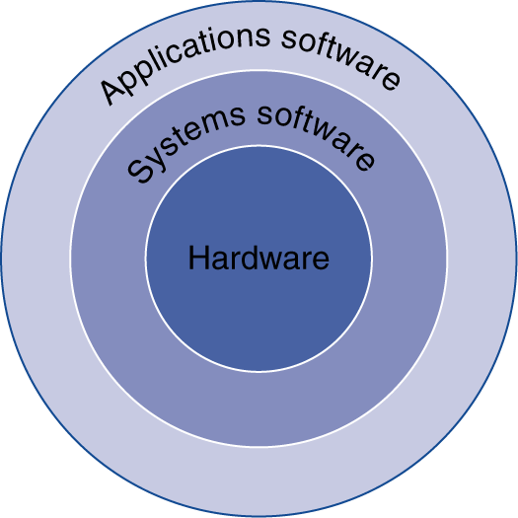
Below Your Program
Application software
Written in high-level language
System software
Compiler: translates HLL code to machine code
Operating System: service code
Handling input/output
Managing memory and storage
Scheduling tasks & sharing resources
Hardware
Processor, memory, I/O controllers
§1.3 Below Your Program

Slide 27
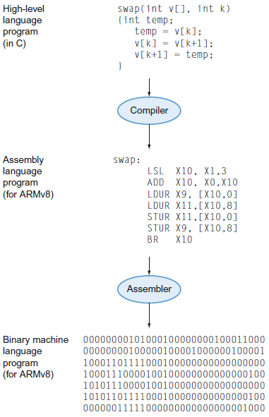
Levels of Program Code
High-level language
Level of abstraction closer to problem domain
Provides for productivity and portability
Assembly language
Textual representation of instructions
Hardware representation
Binary digits (bits)
Encoded instructions and data

Slide 28
Levels of Code
X0 contains the address of v[0] – starting address of array v
X1 contain the loop index k
Each element is 8 bytes, so v[1] is 8 bytes away from v[0]
v[k] is k*8 bytes away from v[0]
or address of v[k] = X0+ 8*X1
Swap: LSL X10, X1, 3 // multiply X1 by 8
ADD X10, X0, X10 // address of v[k] in X10
LDUR X9, [X10,#0] // X9= v[k]
LDUR X11, [X10, #8] // X11 = v[k+1]
STUR X11, [X10, #0] // v[k] = X11= v[k+1]
STUR X9, [X10, #8] // v[k+1] = X9 = v[k]
BR X30 // return
Chapter 1 — Computer Abstractions and Technology — 28

Slide 29
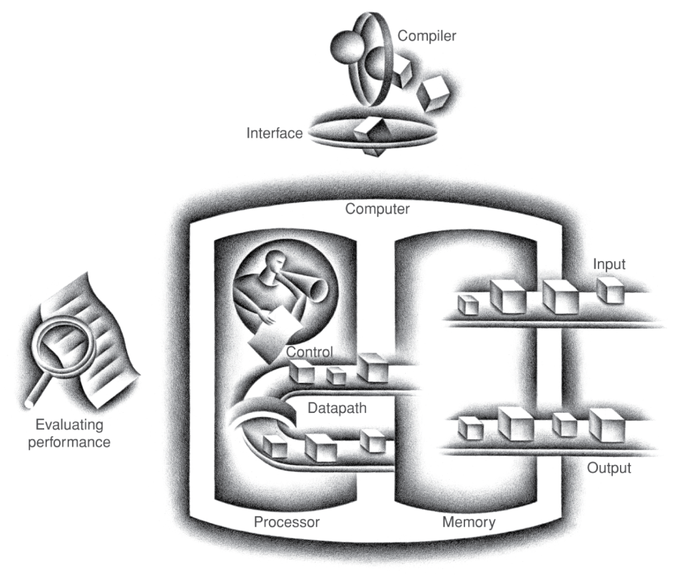
Components of a Computer
Same components for all kinds of computer
Desktop, server, embedded
Input/output includes
User-interface devices
Display, keyboard, mouse
Storage devices
Hard disk, CD/DVD, flash
Network adapters
For communicating with other computers
§1.4 Under the Covers
The BIG Picture

Slide 30

Touchscreen
PostPC device
Supersedes keyboard and mouse
Resistive and Capacitive types
Most tablets, smart phones use capacitive
Capacitive allows multiple touches simultaneously

Slide 31
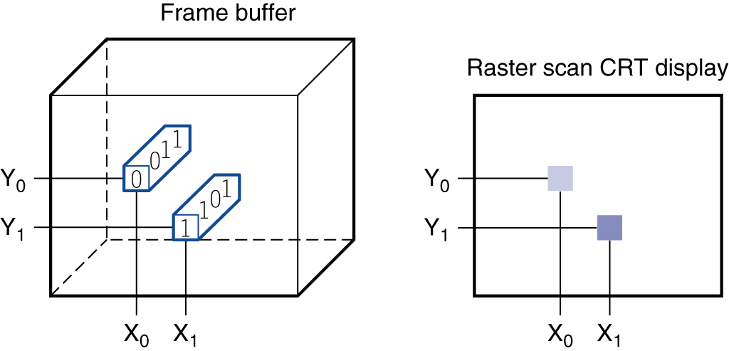
Through the Looking Glass
LCD screen: picture elements (pixels)
Mirrors content of frame buffer memory

Slide 32
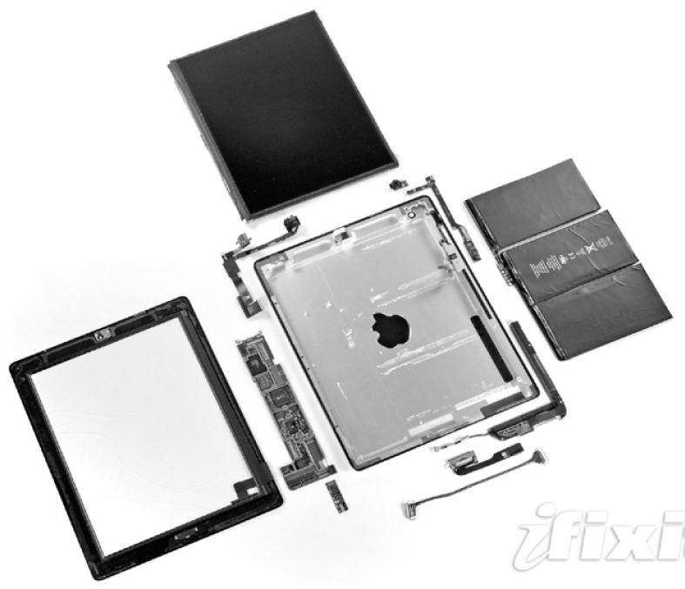
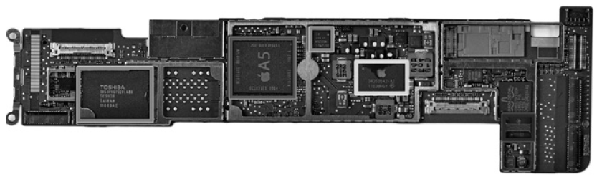
Opening the Box
Capacitive multitouch LCD screen
3.8 V, 25 Watt-hour battery
Computer board

Slide 33
Inside the Processor (CPU)
Datapath: performs operations on data
Arithmetic Logic Unit, Registers,…
Control: sequences datapath, memory, ...
Active hardware unit, which communication paths are used and when
FPU vs GPU vs ALU
Cache memory
Small fast SRAM memory for immediate access to data

Slide 34
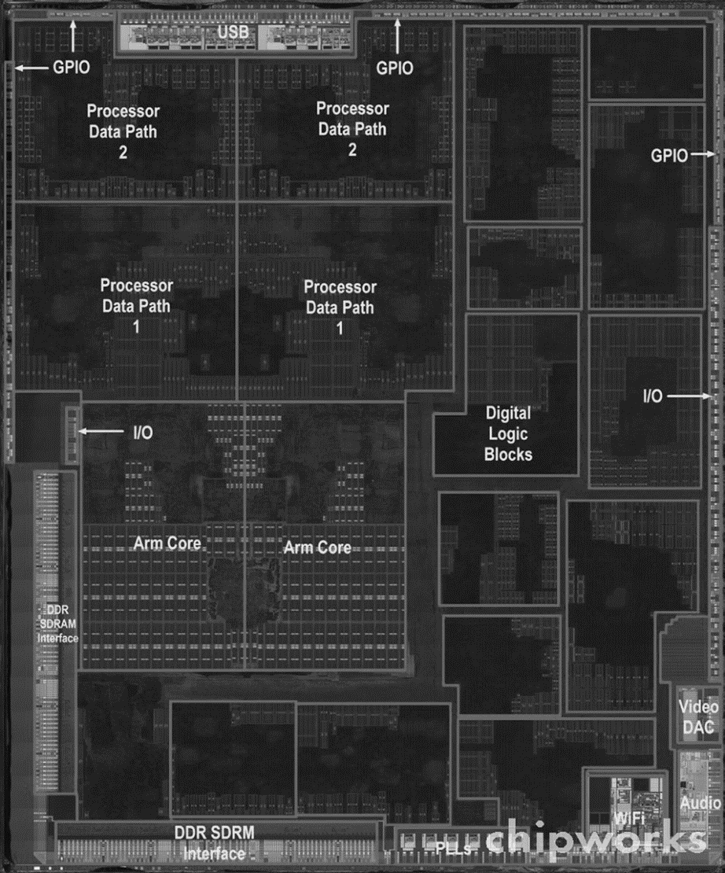
Inside the Processor
Apple A5

Slide 35
Abstractions
The BIG Picture
Abstraction helps us deal with complexity
Hide lower-level detail
Instruction set architecture (ISA)
The hardware/software interface
Application binary interface
The ISA plus system software interface
Implementation
The details underlying and interface

Slide 36
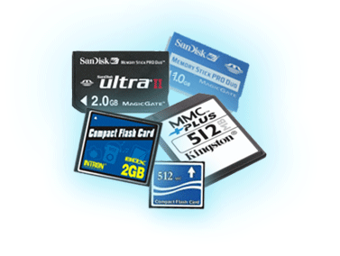
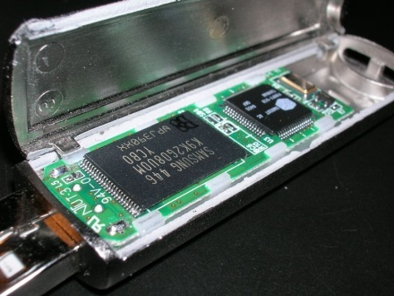
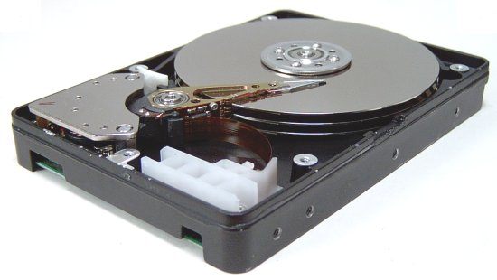
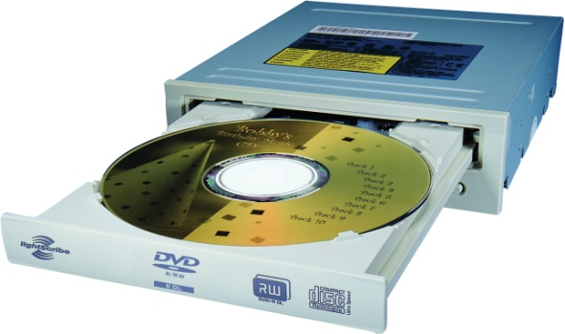
A Safe Place for Data
Volatile main memory
Loses instructions and data when power off
Non-volatile secondary memory
Magnetic disk
Flash memory
Optical disk (CDROM, DVD)

Slide 37

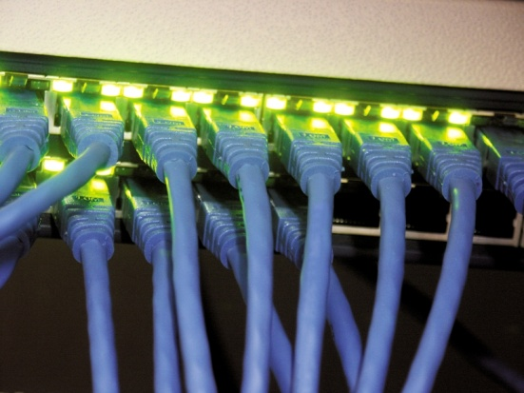
Networks
Communication, resource sharing, nonlocal access
Local area network (LAN): Ethernet
Wide area network (WAN): the Internet
Wireless network: WiFi, Bluetooth

Slide 38
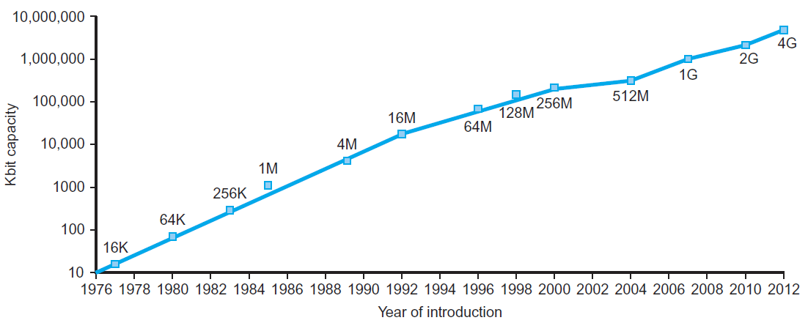
Technology Trends
Electronics technology continues to evolve
Increased capacity and performance
Reduced cost
§1.5 Technologies for Building Processors and Memory
DRAM capacity
Year | Technology | Relative performance/cost
1951 | Vacuum tube | 1
1965 | Transistor | 35
1975 | Integrated circuit (IC) | 900
1995 | Very large scale IC (VLSI) | 2,400,000
2013 | Ultra large scale IC | 250,000,000,000

Slide 39
Semiconductor Technology
Silicon: semiconductor
Add materials to transform properties:
Conductors
Insulators
Switch

Slide 40
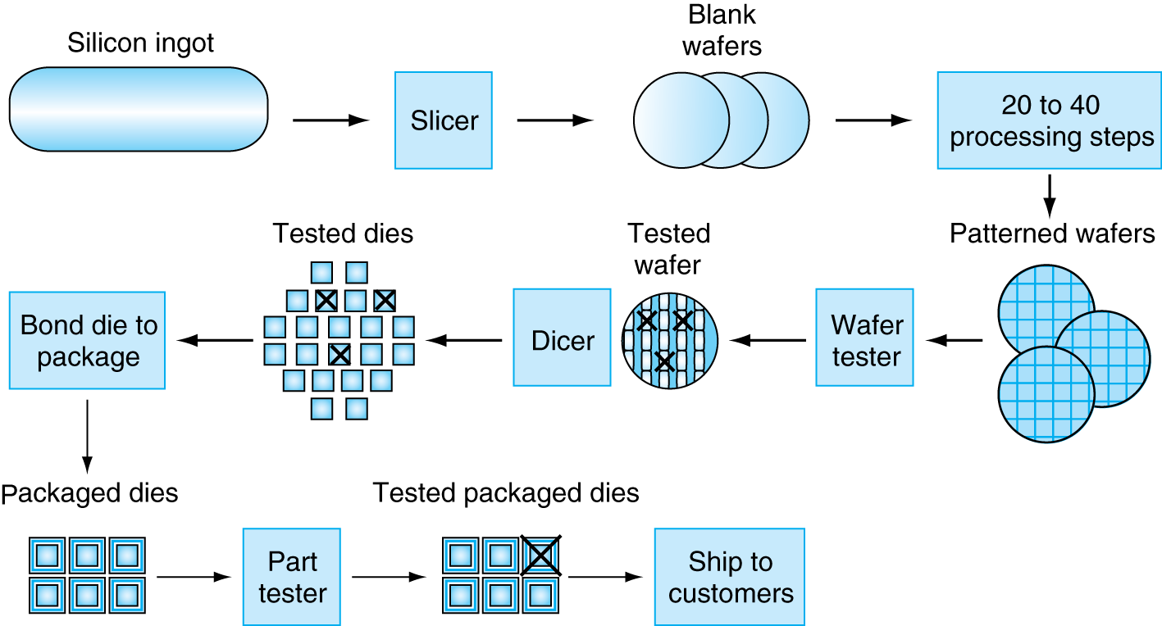
Manufacturing ICs
Yield: proportion of working dies per wafer

Slide 41
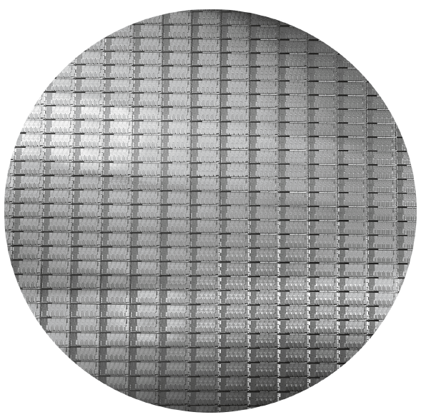
Intel Core i7 Wafer
300mm wafer, 280 chips, 32nm technology
Each chip is 20.7 x 10.5 mm

Slide 42
Integrated Circuit Cost
Nonlinear relation to area and defect rate
Wafer cost and area are fixed
Defect rate determined by manufacturing process
Die area determined by architecture and circuit design

Slide 43
Understanding Performance
What impacts performance? Your code or the hardware?
Algorithm
Determines number of operations executed
Programming language, compiler, and Instruction Set architecture
For example C is more efficient than C++ or Java
Compiler optimizations may also differ
Different optimizations → different number of instructions
Processor and memory system
Determine how fast instructions are executed
Where is the data? fast or slow memory or disk
I/O system (including OS)
Determines how fast I/O operations are executed

Slide 44
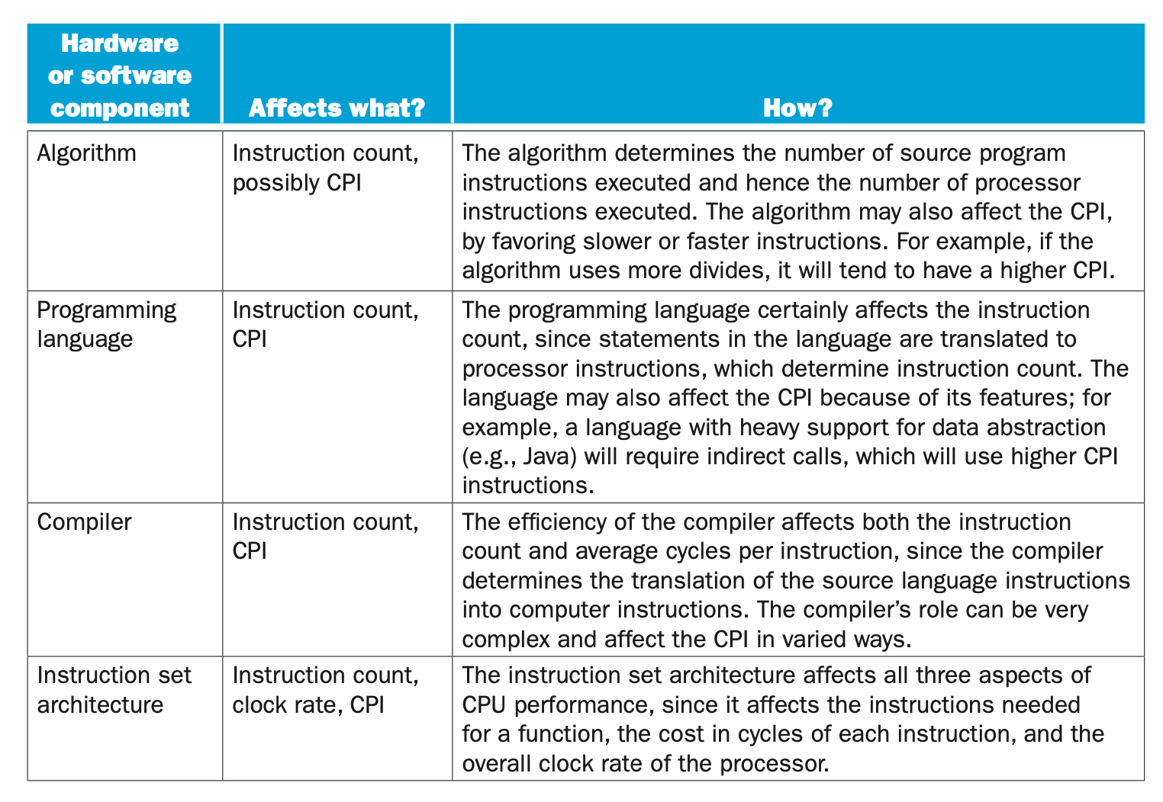

Slide 45
Defining Performance
§1.6 Performance
Which airplane has the best performance?

Slide 46
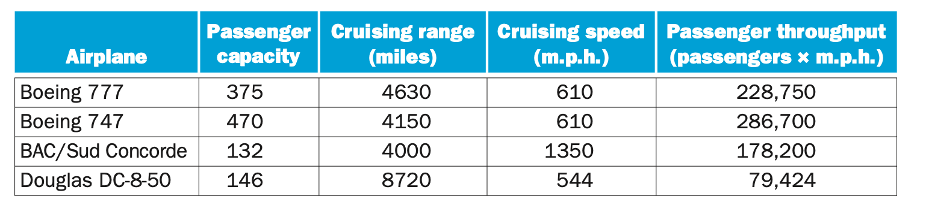
Which aircraft is the best?

Slide 47
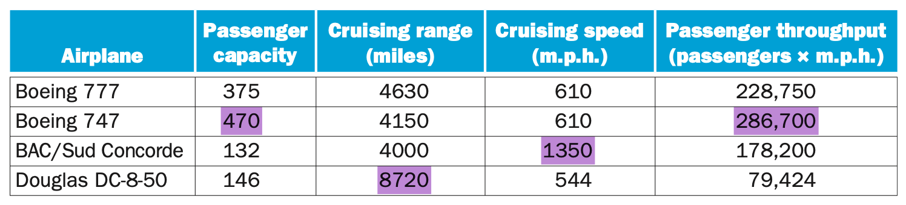
What matters most?
Who gets me there the fastest?
Who carries the most people?
Who flies the longest?
Who flies the most people the fastest?

Slide 48
Defining Performance
Performance may mean different things
Different ways of measuring how good a system is
Which airplane has the best performance?

Slide 49
What changes?
Do the following changes to a computer system increase throughput, decrease response time, or both?
1. Replacing the processor with one having a faster clock speed
2. Adding additional processors for separate tasks

Slide 50
Response Time and Throughput
Response time
How long it takes to do a task
Throughput
Total work done per unit time
e.g., tasks/transactions/… per hour
How are response time and throughput affected by
Replacing the processor with a faster version?
Adding more processors?
We’ll focus on response time for now…

Slide 51
Relative Performance
Define Performance = 1/Execution Time
“X is n time faster than Y”
Example: time taken to run a program
10s on A, 15s on B
Execution Time_{B} / Execution Time_{A} = 15s / 10s = 1.5
So A is 1.5 times faster than B

Slide 52
Measuring Execution Time
Elapsed time
Total response time, including all aspects
Processing, I/O, OS overhead, idle time
Determines system performance
CPU time
Time spent processing a given job
Discounts I/O time, other jobs’ shares
Comprises user CPU time and system CPU time
Different programs are affected differently by CPU and system performance

Slide 53
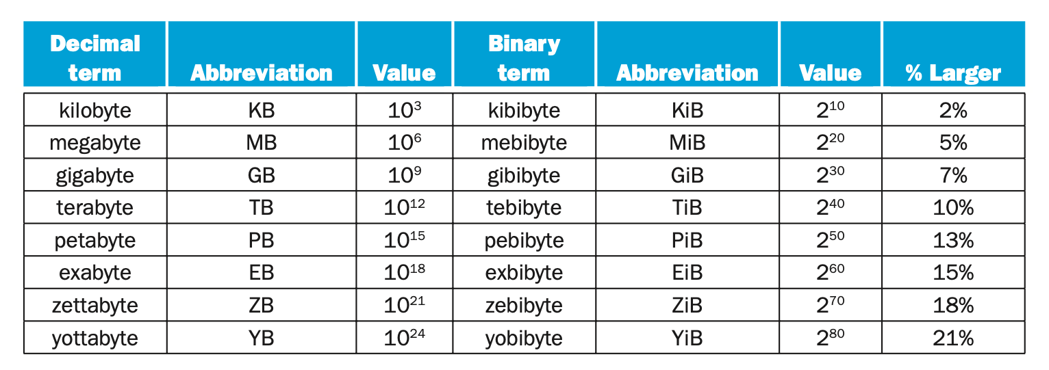
Measuring

Slide 54
Measuring Time
Abbreviation | Name | Length | Portion of a Sec | Decimal Value
s | Second | 10⁰ Sec | 1 Second | 1.0
ms | Milli | 10⁻³ Sec | 1 thousandth of a sec | 0.001
μs (us) | Micro | 10⁻⁶ Sec | 1 millionth of a sec | 0.000001
ns | Nano | 10⁻⁹ Sec | 1 billionth of a sec | 0.000000001
ps | Pico | 10⁻¹² Sec | 1 trillionth of a sec | 0.000000000001

Slide 55
Clock Rate : Clock Cycle
Name | Cycles/sec Clock Rate | Sec / Cycle Clock Cycle | Sec / Cycle Clock Cycle | Seconds / 1 cycle
1 MHz | 1 x 10⁶ | 1 x 10⁻⁶ | 1 μs
5 MHz | 5 x 10⁶ | 200 x 10⁻⁹ | 200 ns | 200 ns
1 GHz | 1 x 10⁹ | 1 x 10⁻⁹ | 1 ns | 1 ns
2.5 GHz | 2.5 x 10⁹ | 400 x 10⁻¹² | 400 ps | .4 ns
5.0 GHz | 5.0 x 10⁹ | 200 x 10⁻¹² | 200 ps | .2 ns
6 GHz | 6 x 10⁹ | 167 x 10⁻¹² | 167 ps | .166 ns
3 THz | 3 x 10¹² | 333 x 10⁻¹⁵ | 333 fs | 0.000333ns

Slide 56
Measuring Speed
Name |  | Unit | Value
kiloFLOPS | Thousands | kFLOPS | 10³
megaFLOPS | Millions | MFLOPS | 10⁶
gigaFLOPS | Billions | GFLOPS | 10⁹
teraFLOPS | Trillions | TFLOPS | 10¹²
petaFLOPS | Quad | PFLOPS | 10¹⁵
exaFLOPS | Quint | EFLOPS | 10¹⁸
zettaFLOPS | Sex | ZFLOPS | 10²¹
yottaFLOPS | Sep | YFLOPS | 10²⁴
ronnaFLOPS | Oct | RFLOPS | 10²⁷
quettaFLOPS | Non | QFLOPS | 10³⁰
Chapter 1 — Computer Abstractions and Technology — 56

Slide 57
CPU Clocking
Operation of digital hardware governed by a constant-rate clock
Clock period
Clock (cycles)
Data transfer and computation
Update state
Clock period: duration of a clock cycle
e.g., 250ps = 0.25ns = 250×10^{–12}s
Clock frequency (rate): cycles per second
e.g., 4.0GHz = 4000MHz = 4.0×10⁹Hz

Slide 58
Terms and 1 Equation
Clock Rate cycles/sec, Hz, big number
Clock Cycle sec/cycle, small number
CPI Cycles / Instruction
Instructions # of instructions
Cycles # of cycles to do one instruction
CPU Time # seconds to run app

Slide 59
Generalizing the Equation
The number of instructions is not sufficient to calculate CPU time.
Different chips require more cycles to complete the same number of instructions.
Faster chips often require additional cycles to complete an operation

Slide 60
A Peak at the Instructions
Mnemonic | Format | Width | Binary
B | B | 6 | OOO1O1
B.Cond | CB | 8 | O1O1O1OO
AND | R | 11 | 1OOO1O1OOOO
ADD | R | 11 | 1OOO1O11OOO
ADDI | I | 10 | 1OO1OOO1OO
BL | B | 6 | 1OO1O1
CBZ | CB | 8 | 1O11O1OO
CBNZ | CB | 8 | 1O11O1O1
SUB | R | 11 | 11OO1O11OOO
SUBI | I | 10 | 11O1OOO1OO
MOVE | IM | 9 | 11O1OO1O1
LSR | R | 11 | 11O1OO11O1O
LSL | R | 11 | 11O1OO11O11
BR | R | 11 | 11O1O11OOOO

Slide 61
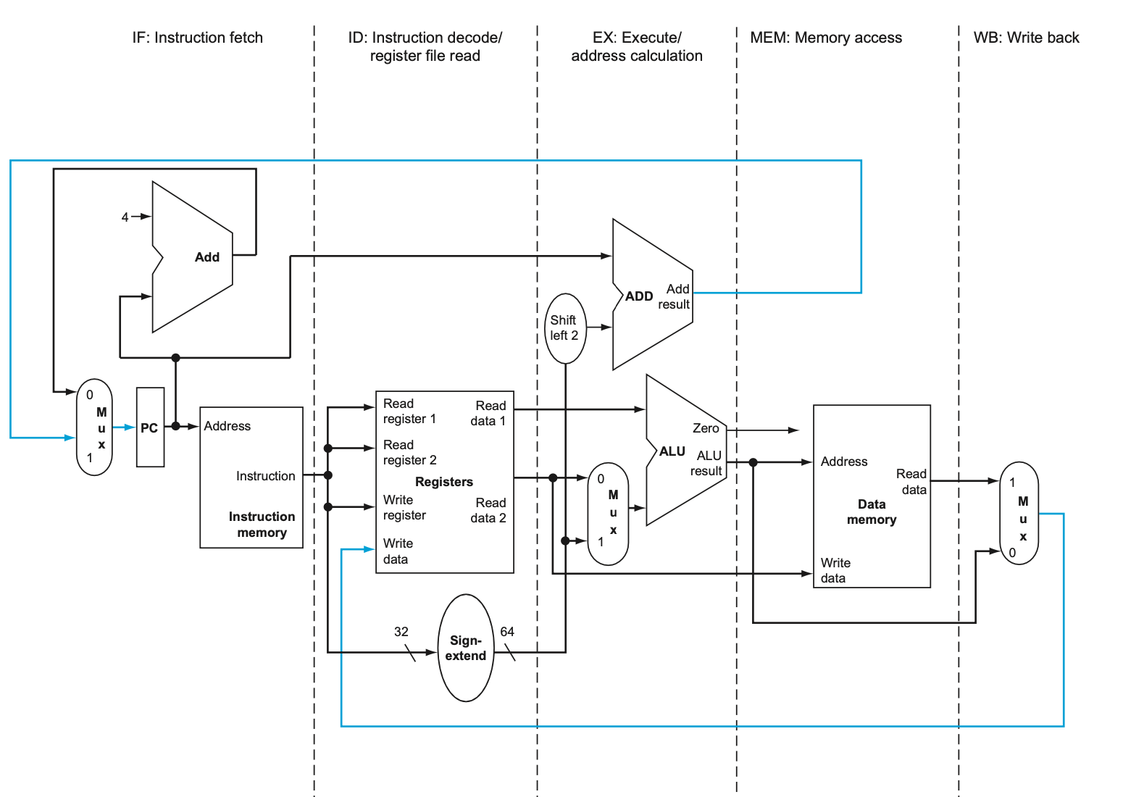
Datapath (chap 4)

Slide 62
CPU Time
Performance improved by
Reducing number of clock cycles
Increasing clock rate
Hardware designer must often trade off clock rate against cycle count

Slide 63
CPU Time Example
Computer A: 2GHz clock, 10s CPU time
Designing Computer B
Aim for 6s CPU time
Can do faster clock, but causes 1.2 × clock cycles
How fast must Computer B clock be?

Slide 64
Instruction Count and CPI
Instruction Count for a program
Determined by program, ISA and compiler
Average cycles per instruction
Determined by CPU hardware
If different instructions have different CPI
Average CPI affected by instruction mix

Slide 65
CPI Example
Computer A: Cycle Time = 250ps, CPI = 2.0
Computer B: Cycle Time = 500ps, CPI = 1.2
Same ISA
Which is faster, and by how much?
A is faster…
…by this much

Slide 66
CPI in More Detail
If different instruction classes take different numbers of cycles
Weighted average CPI
Relative frequency

Slide 67
CPI in More Detail
Note not all instructions take the same amount time → may need different number of cycles
For example, let us assume we have
100 Add instructions (1 cycle for add)
50 Load instructions (5 cycles for load)
50 Multiply (3 cycles for multiply)
Clock cycles = 100 * 1 + 50 * 5 + 50 * 3 = 500 cycles
Weighted average CPI
In the previous example, total # instructions = 100 + 50 + 50 = 200
CPI = 1 * (100 /200) + 5 * (50 /200) + 3 * (50 /200)
= 1 * 0.5 + 5 * 0.25 + 3 *0.25
= 0.5 + 1.25 + 0.75
= 2.5 cycles
On average each instruction takes 2.5 cycles/instruction (CPI)

Slide 68
CPI Example
Alternative compiled code sequences using instructions in classes A, B, C
Class | A | B | C | Inst Count
CPI for class | 1 | 2 | 3
IC in sequence 1 | 2 | 1 | 2 | 5
IC in sequence 2 | 4 | 1 | 1 | 6
Sequence 1: IC = 5
Clock Cycles = 2×1 + 1×2 + 2×3 = 10
Avg. CPI = 10/5 = 2.0
Sequence 2: IC = 6
Clock Cycles = 4×1 + 1×2 + 1×3 = 9
Avg. CPI = 9/6 = 1.5

Slide 69
Another CPI Example
The average frequencies for various instruction types.
ALU operations occur 43% of the time and need 1 clock cycle to execute
Load instructions occur 21% of the time and need 2 cycles
Store instructions occur 12% of the time and need 2 cycles
Branch instructions occur 24% of the time and need 2 cycles
How do we get CPI = average cycles per instruction?
The average number of cycles per instruction = CPI=
0.43 * 1. + 0.21 * 2. + 0.12 * 2. + 0.24 * 2 = 1.57 Cycles per instruction
Once we have the CPI, and clock speed, we can find the ratings of a processor
If we are using 1Ghz processor (10⁹ cycles per second)
10⁹ c/s / CPI c/i = 10⁹ /1.57 = 637 Million instructions / sec
sec/instruction = 1 / 637x10⁶ = 1.57x 10⁻⁹ sec / instructions
Execution time = instruction_count x 1.57*10⁻⁹ Sec

Slide 70
One more example – from textbook
1.5. Consider 3 different processors P1, P2, P3 executing the SAME instructions
P1 clock is 3GHz and a CPI of 1.5
P2 clock is 2.5GHz and a CPI of 1.0
P3 clock is 4 GHz and a CPI of 2.2
a). Which process has highest performance in instructions per second
Execution time = (Instruction_count)*(CPI)/(Clock_rate)
We keep IC constant → same program
Execution time on P1 = (IC) * 1.5 / 3.0*10⁹ = 0.50*10⁻⁹sec
Execution time on P2 = (IC) * 1.0 / 2.5*10⁹ = 0.40*10⁻⁹sec
Execution time on P3 = (IC) * 2.2 / 4.0*10⁹ = 0.55*10⁻⁹sec
P2 is faster
MIPS = (Clock_rate)/CPI
Inst/sec of P1 = 3*10⁹ /1.5 = 2,000 MIPS = 2.000 x 10⁹
Inst/sec of P2 = 2.5*10⁹/1.0 = 2,500 MIPS = 2.500 x 10⁹
Inst/sec of P3 = 4*10⁹/2.2. = 1,818 MIPS = 1.818 x 10⁹
P2 has higher rating

Slide 71
One more example – from textbook
b. If the processors execute a program in 10 seconds find the number of cycles and number of instructions (note we are executing different programs on the 3 processors)
Total cycles = Clock_rate * Execution time; Instruction Count = Total_cycles / CPI
Cycles on P1 = 3.0*10⁹ * 10 = 3.0*10¹⁰ IC on P1 = 3.0 * 10¹⁰ / 1.5 = 2.0*10¹⁰
Cycles on P2 = 2.5*10⁹ * 10 = 2.5*10¹⁰ IC on P2 = 2.5 * 10¹⁰/ 1.0 = 2.5*10¹⁰
Cycles on P3 = 4.0*10⁹ * 10 = 4.0*10¹⁰ IC on P3 = 4.0 *10¹⁰ / 2.2 = 1.8*10¹⁰
c. We are trying to reduce the execution time by 30% using faster clock,
but this leads to an increase of 20% in CPI. What clock rate should we have to get this time reduction?
Execution time = (Instruction_count)*(CPI)/(Clock_rate)
New execution time = 0.7*(original execution time) = (IC)*1.2*(original CPI)/(new clock rate)
IC will not change
New clock rate = (1.2/0.7) original clock rate = 1.71 * original clock rate
P1 should run at 3.0 * 1.71 = 5.14 GHz
P2 should run at 2.5 * 1.71 = 4.29 GHz
P3 should run at 4.0 * 1.71 = 6.86 GHz

Slide 72
Slowest to Fastest
Chips order from slowest to fastest
Hz cycle / sec sec / cycle Xs / cycle ps / cycle
3.3 Mhz 3.3 x 10⁶ 303 x 10⁻⁰⁹ 303 ns 303,000 ps
300 Mhz 300 x 10⁶ 3.3 x 10⁻⁰⁹ 3.33 ns 3,333 ps
1.0 GHz 1,000 x 10⁶ 1 x 10⁻⁰⁹ 1.00 ns 1000 ps
2.0 Ghz 2,000 x 10⁶ 500 x 10⁻¹² 500 ps 500 ps
2.5 GHz 2,500 x 10⁶ 400 x 10⁻¹² 400 ps 400 ps
4.0 Ghz 4,000 x 10⁶ 250 x 10⁻¹² 250 ps 250 ps
1.0 Thz 1,000,000 x 10⁶ 1 x 10⁻¹² 1.00 ps 1 ps
4.0 Thz 4,000,000 x 10⁶ 250 x 10⁻¹⁵ 250 fs .250 ps

Slide 73
Reporting Performance Data
Execution time for one program?
Execution times for MANY programs (benchmarks!)
Average execution time across all programs
We can also consider using “normalized” execution times (or relative execution times)
Execution times on some standard machine
Then take ratio of execution times of your machine with the standard machine
Execute a wide variety of “benchmark” programs
For example, use SPEC CPU2006 benchmarks (CPUInt and CPUFloat)
Focus on CPU performance (almost no I/O)

Slide 74
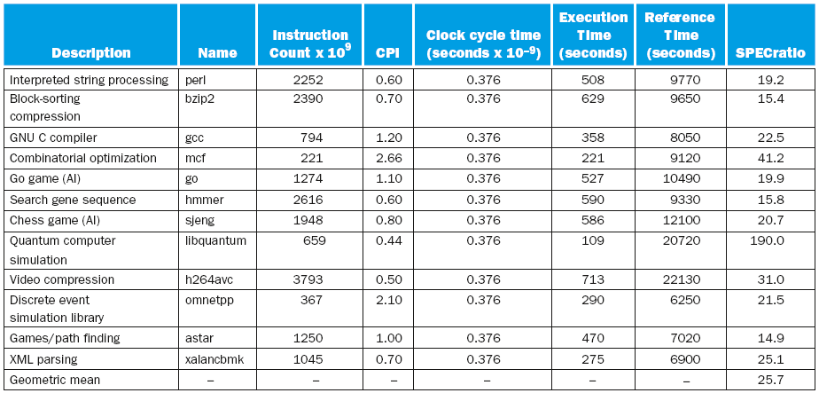
CINT2006 for Intel Core i7 920
Reference time → some known CPU (VAX)

Slide 75
An Example: 1.9 page 56-57
1.9. Assume arithmetic, load/store and branch instructions have CPIs of 1, 12, 5.
Assume that on a single processor a program executes 2.5*10⁹ arithmetic, 1.28*10⁹ load/store and 256*10⁶ branch instructions. The clock frequency is 2 GHz.
Let us start with single processor case
2.56 *10⁹ arithmetic instructions and each takes 1 cycle
1.28 *10⁹ Load/Store instructions and each takes 12 cycles
256 *10⁶ Branch instructions and each takes 5 cycles
Total number of instructions executed =4,096 * 10⁶
CPI = (total cycles)/(total instructions)
[2.56 *10⁹ * 1 +
1.28 *10⁹ * 12 +
256 *10⁶ * 5]/4096 * 10⁶ = 4.6875
Execution time = (instruction count)* CPI / (clock rate)
= (4096*10⁶ * 4.6875)/2*10⁹ =9.6 sec

Slide 76
Performance Summary
The BIG Picture
Performance depends on
Algorithm: affects IC, possibly CPI
Programming language: affects IC, CPI
Compiler: affects IC, CPI
Instruction Set Architecture: affects IC, CPI, T_{c}

Slide 77
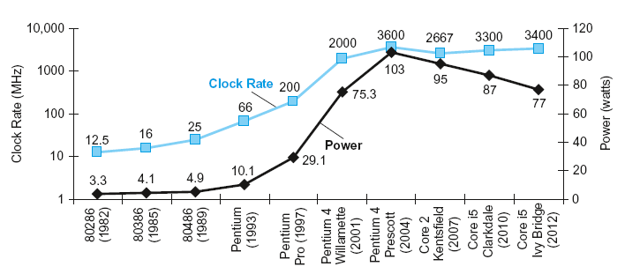
Power Trends
§1.7 The Power Wall
In CMOS IC technology
×30
5V → 1V
×1000

Slide 78
Reducing Power
Suppose a new CPU has
85% of capacitive load of old CPU
15% voltage and 15% frequency reduction
The power wall
We can’t reduce voltage further
We can’t remove more heat
How else can we improve performance?

Slide 79
Why we need multiple cores
A couple of observations from the problem description
Clock speeds are not increasing
Static power is becoming a larger fraction of Total Power Dissipation (TD)
We can’t reduce voltage further (we are already at 0.7v)
Any reduction can lead to errors
With more power, more heat will be generated → we cannot remove heat fast enough
How else can we improve performance?
We may need to use “parallelism” – use multiple cores and multi-threading

Slide 80
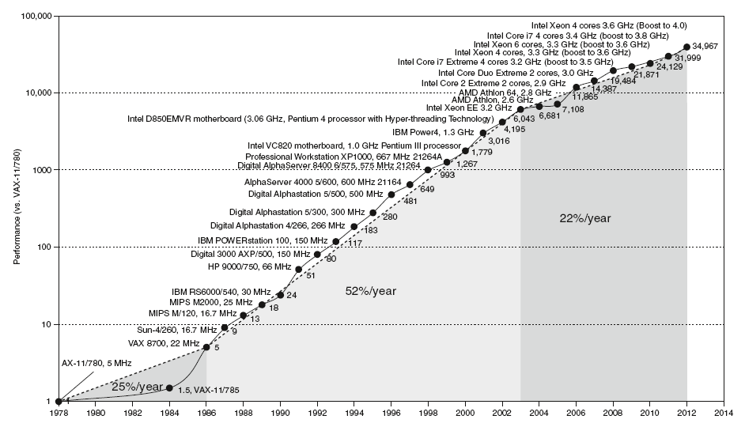
Uniprocessor Performance
§1.8 The Sea Change: The Switch to Multiprocessors
Constrained by power, instruction-level parallelism, memory latency

Slide 81
Multiprocessors
Multicore microprocessors
More than one processor per chip
Requires explicitly parallel programming
Compare with instruction level parallelism
Hardware executes multiple instructions at once
Hidden from the programmer
Hard to do
Programming for performance
Load balancing
Optimizing communication and synchronization

Slide 82
SPEC CPU Benchmark
Programs used to measure performance
Supposedly typical of actual workload
Standard Performance Evaluation Corp (SPEC)
Develops benchmarks for CPU, I/O, Web, …
SPEC CPU2006
Elapsed time to execute a selection of programs
Negligible I/O, so focuses on CPU performance
Normalize relative to reference machine
Summarize as geometric mean of performance ratios
CINT2006 (integer) and CFP2006 (floating-point)

Slide 83
CINT2006 for Intel Core i7 920

Slide 84
SPEC Power Benchmark
Power consumption of server at different workload levels
Performance: ssj_ops/sec
Power: Watts (Joules/sec)

Slide 85
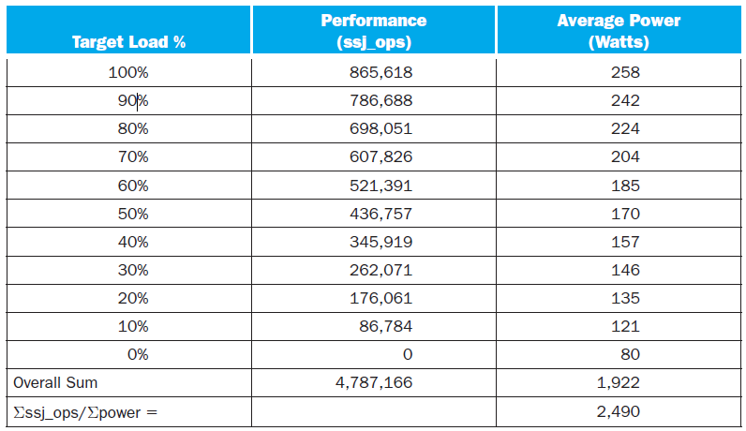
SPECpower_ssj2008 for Xeon X5650

Slide 86
Pitfall: Amdahl’s Law
Improving an aspect of a computer and expecting a proportional improvement in overall performance
§1.10 Fallacies and Pitfalls
Example: multiply accounts for 80s/100s
How much improvement in multiply performance to get 5× overall?
Can’t be done!
Corollary: make the common case fast

Slide 87
Fallacy: Low Power at Idle
Look back at i7 power benchmark
At 100% load: 258W
At 50% load: 170W (66%)
At 10% load: 121W (47%)
Google data center
Mostly operates at 10% – 50% load
At 100% load less than 1% of the time
Consider designing processors to make power proportional to load

Slide 88
Pitfall: MIPS as a Performance Metric
MIPS: Millions of Instructions Per Second
Doesn’t account for
Differences in ISAs between computers
Differences in complexity between instructions
CPI varies between programs on a given CPU

Slide 89
Concluding Remarks
Cost/performance is improving
Due to underlying technology development
Hierarchical layers of abstraction
In both hardware and software
Instruction set architecture
The hardware/software interface
Execution time: the best performance measure
Power is a limiting factor
Use parallelism to improve performance
§1.9 Concluding Remarks

